Slide 1
IETF Hackathon -Comprehensive Hardware Evaluation of Multicast Source Routing over IPv6(MSR6) on Experimental Network
IETF 119
16–17 March 2024
Brisbane, Australia
Notes:
Hello everyone, my name is Jiang Yuxin, I’m a Master student in Beijing University of posts and Telecommunications. When we were looking for some solutions for IP multicast, we noticed some drafts of MSR6, and had some interest in them. So we implement them on our Experimental Network and provide a Hardware evaluation of MSR6.

Slide 2
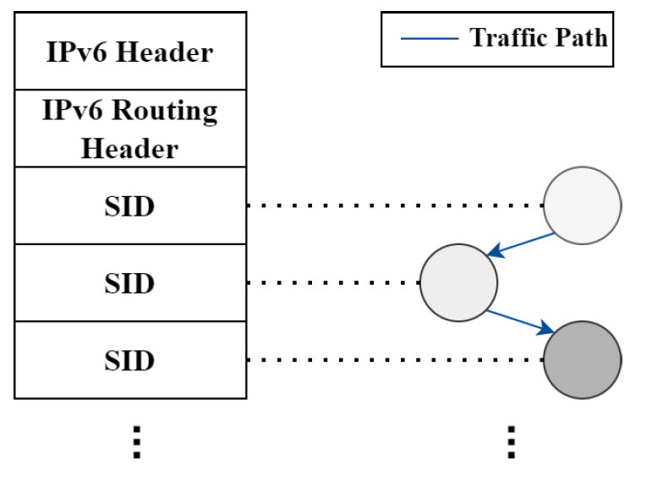
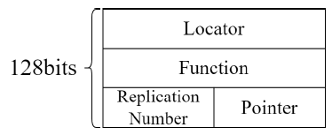
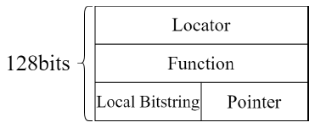
Hackathon Plan
Implement MSR6 TE and MSR6 TE with RLB on hardware using the P4 language.
Conduct comprehensive hardware emulations based on a testbed with 5 hardware P4 switches on CENI(China Environment for Network Innovations).
Documents
https://datatracker.ietf.org/doc/draft-geng-msr6-traffic-engineering/02
https://datatracker.ietf.org/doc/draft-geng-msr6-rlb-segment/01
https://datatracker.ietf.org/doc/draft-chen-pim-srv6-p2mp-path/
SID Structure of MSR6 TE
SID Structure of MSR6 TE with RLB
Notes:
This slide shows the main works and some useful links.
Both of MSR6 TE and TE with LRB use SIDs in IPv6 expansion header to schedule multicast traffic. But the structure of SID is designed differently.
For the work, we first implement these two MSR6 solutions on hardware using the P4 language and conduct hardware emulations based on a testbed with 5 hardware P4 switches on CENI.

Slide 3
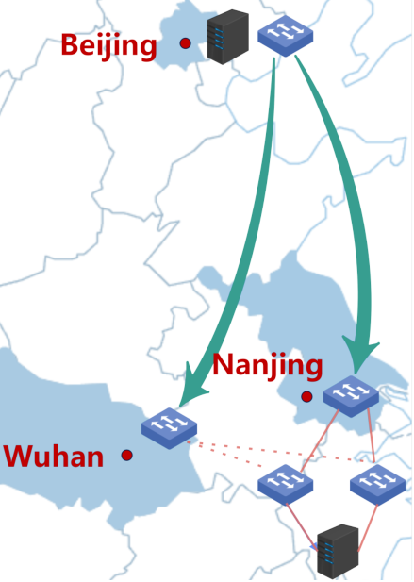
Experimental Topology
Ingress Node: Beijing, encapsulate to form MSR6 packets [deploy a video server to run real video traffic]
Transit Node: Wuhan and Nanjing, receive the MSR6 packets and copy them into 2 copies based on specific fields in the MRH [deploy monitoring devices at each forwarding node]
Egress Node: Nanjing, decapsulate the MSR6 packets [deploy a server to capture packets to verify the correctness of the packet after processing]
Figure 1. Experimental Topology
Notes:
The topology was constructed using P4 switches as the ingress, transit, and egress nodes in the MSR domain. At the ingress node Beijing), incoming packets are encapsulated to form MSR6 packets. The transit nodes(at Wuhan and Nanjing) receive the MSR6 packets and copy them into 2 copies based on the MRH. After that, transit nodes send them to 2 egress nodes at Nanjing respectively. The egress node receives the MSR6 packet and decapsulates it, restoring the packet to its state before entering the MSR domain.

Slide 4
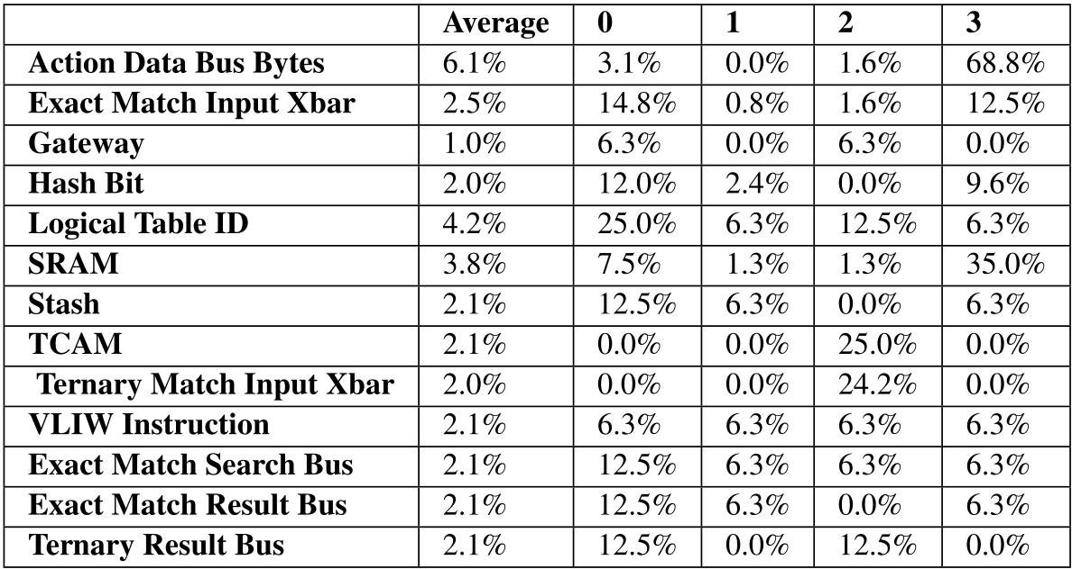
Hardware Resource Usage
The P4 program used in this project only uses 4 of the 12 stages, with most stages being idle and the resource occupancy rate in the used stages is not high.
It can be considered that this program will not bring a bottleneck on hardware resources.
Table 1. Resource Occupancy of MSR6 TE
Notes:
Firstly, regarding to Hardware Resource Usage of MSR6 TE. This column, which shows the resource occupancy rate is not high, and the P4 program used in this project only uses 4 of the 12 stages. Thus, It can be considered that this program will not bring a bottleneck on hardware resources.

Slide 5
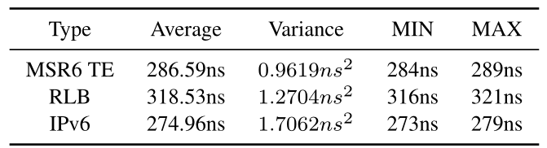
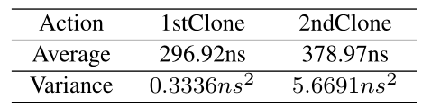
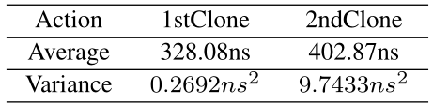
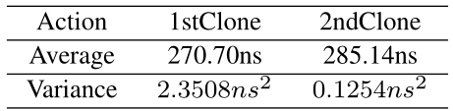
Delay Measurement
Encapsulation Delay
Clone and Forward Delay
Table 2. MSR6 TE’s delay of clone and forward
①MSR TE and RLB cause delays of about 287ns and 319ns respectively.
②The encapsulation delay of the MSR6 TE scheme is 3.5% higher than the IPv6 forwarding delay, and the encapsulation delay of the RLB scheme is 15% higher than the IPv6 forwarding delay.
Table 3. MSR6 TE with RLB’s delay of clone and forward
Table 4. IPv6’s delay of clone and forward
Notes:
Then, we conducted time delay measurements.
We use the timestamp function in P4 to measure delay. Timestamp records the time when packets enter ingress pipeline and egress pipeline.
For Encapsulation Delay on ingress node, the data shows left here. And for Clone and Forward Delay on transit nodes, the data shows in table 2 and 3.
It can be seen that Compared to the delay of IPv6, MSR6 TE brings less than 30 ns increase in process delay while MSR6 TE with RLB brings about 60 ns increase. In the actual network environment, this increment can be considered to have little influence.

Slide 6
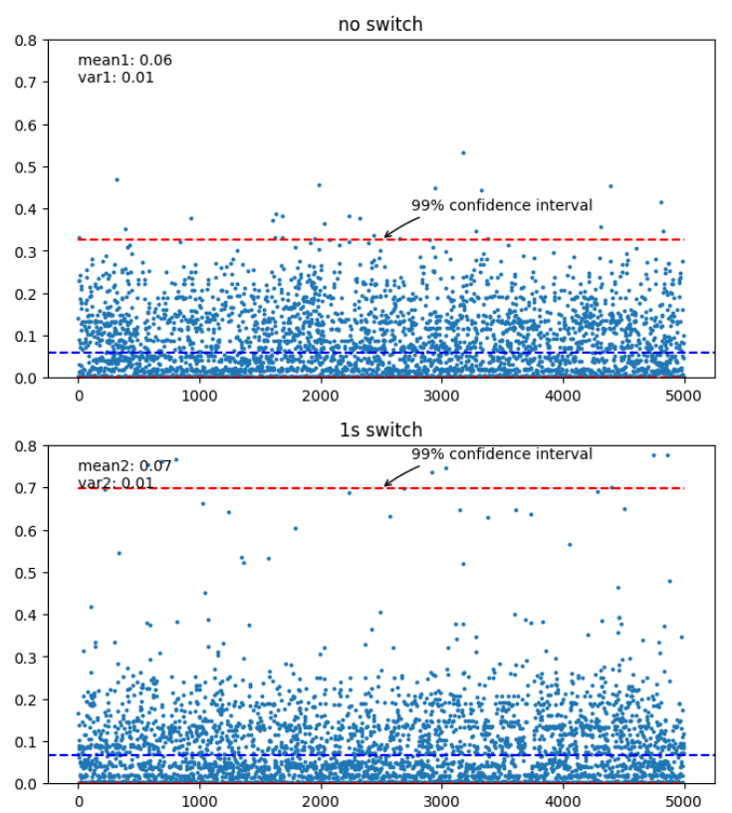
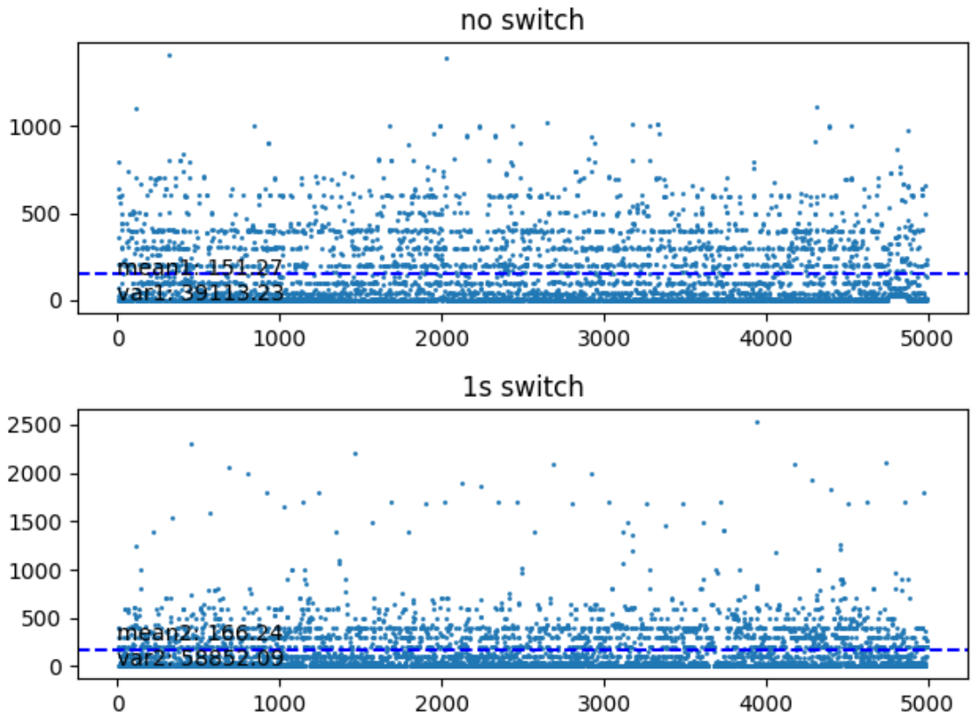
Stability
The packet sending time at the sending end is t1, t2,. . . , and the packet receiving time at the receiving end is T1, T2,. . . . We have set a value to further measure stability
Figure 2. The difference between the sending interval and the receiving interval
Figure 3. Distribution of |(T2 − T1) −(t2 − t1)|/ ((t2 − t1))
It can be seen that when the long delay link is involved, the turbulence of the interval between sending time and receiving time rises, but the rate of increase is acceptable. Therefore, this system is considered to a good stability.
Notes:
For the stability test, A total of 5000 packets were sent and the difference between the sending interval and the receiving interval was calculated. Measurements were made under conditions where no switching was performed and where the path was switched once per second(on the left) and on the right we set a value to further measure stability.
Before the experiment, we changed the link between Beijing and Wuhan to a link with a long delay.
Both simulation results indicate that when the long delay link is involved, the turbulence of the interval between sending time and receiving time rises, but the rate of increase is acceptable. Therefore, this system is considered to a good stability.

Slide 7
Wrap Up
Team members:
Weihong Wu (wuweihong@bupt.edu.cn)
Yunyi Tang (tangyunyi0708@bupt.edu.cn)
Yuxin Jiang (jyxin@bupt.edu.cn)
Yutong Zhao(zhaoyutong@bupt.edu.cn)
Jiang Liu (liujiang@bupt.edu.cn)
Pei Anbang(anbangpei@bupt.edu.cn)
Notes:
That‘s all we want to share about our Hardware evaluation, if you have some interests or puzzles about the demo or any others, just contact us.
So, thanks for listening.

